Slide 1
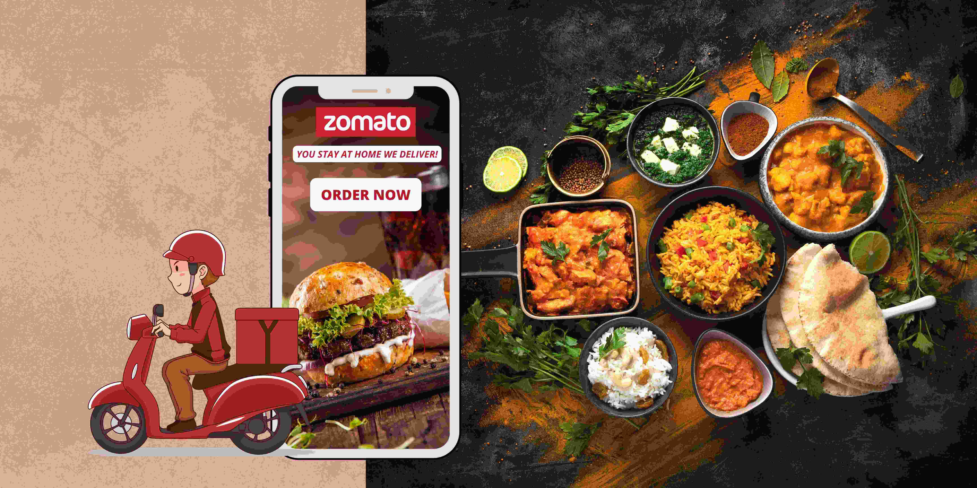
ZOMATO
DATA
ANALYTICS
PROJECT

Slide 2
Introduction

Slide 3
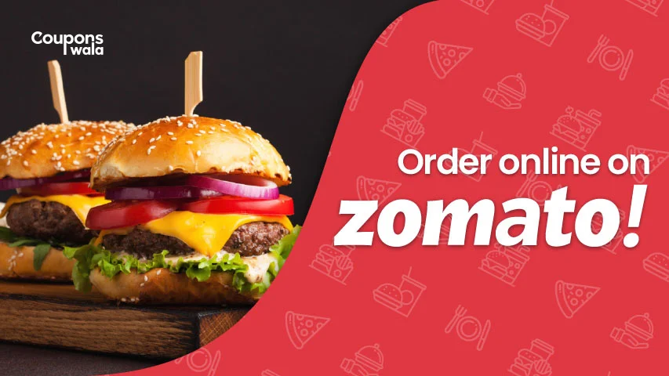
Introduction:
Project Overview:
- About Zomato:
A leading platform for restaurant discovery and food delivery.
Operating globally with a significant user base.
Project Aim:
To analyse and derive insights from Zomato’s restaurant and customer data.
Objectives and Goals:
To find out the main KPI’s and draw inferences and conclusions from it using different data analysis and visualization tools.

Slide 4




Tools Used

Slide 5
Analysis & Findings

Slide 6
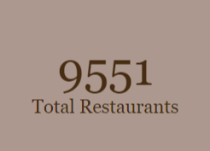
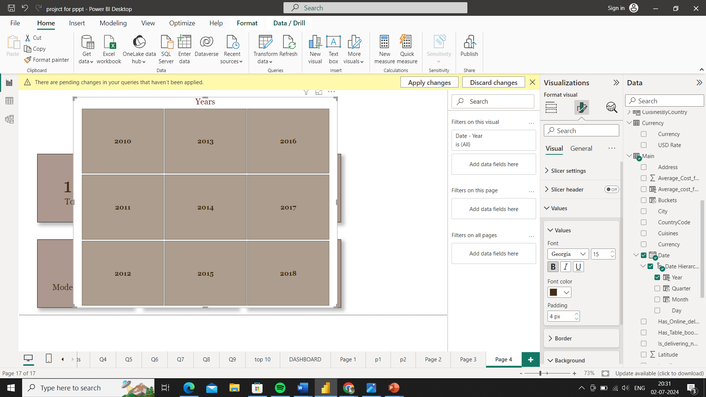
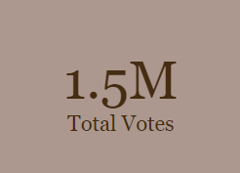
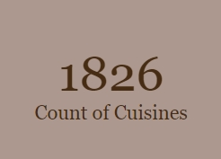
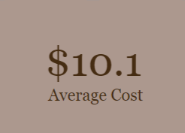
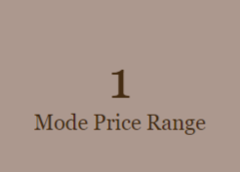
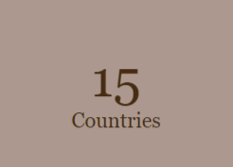
Key Metrices

Slide 7

AVERAGE COST ANALYSIS

Slide 8
Average Cost Analysis
Country Wise Insights:
Highest Maximum Average Cost for Two:
Singapore stands out with the highest maximum average cost for two people at $500K, indicating
a presence of extremely high-end dining options.
2. Lowest Maximum Average Cost for Two:
Sri Lanka has the lowest maximum average cost for two people at $15.3, suggesting a more affordable
dining scene.
Countries with Highest Average Cost for Two:
India ($64.7K), USA ($11.3K), and UK ($4.7K):
These countries have a high average cost for two, indicating a higher spending power and a market
for premium dining experiences.
4. Countries with Lowest Average Cost for Two:
Sri Lanka ($161K), Canada ($145K), and Turkey ($144K):
Surprisingly, these countries show lower average costs for two in certain contexts which might reflect
unique, high-cost dining experiences skewing the average.

Slide 9
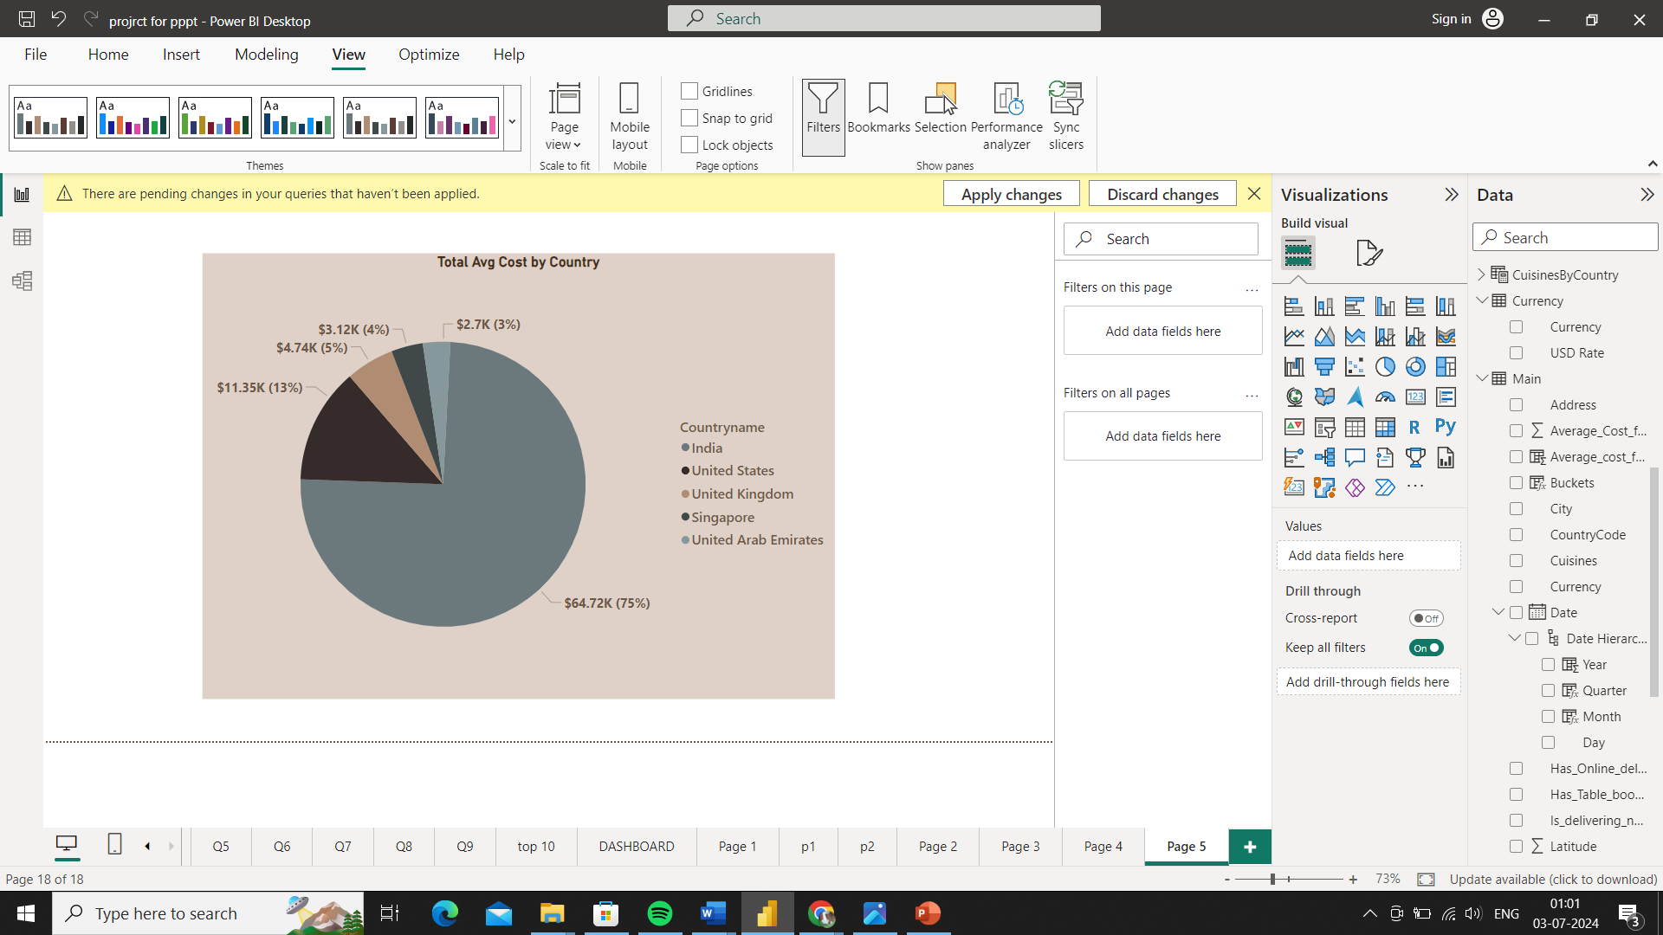
Average Cost Analysis
Cities with Highest Average Cost for Two: New Delhi ($39K), Gurgaon ($9.5K), Noida ($6.9K), Singapore, and London ($3.1K):
These cities are major economic hubs with significant disposable income, supporting higher dining costs.
Cities with Lowest Average Cost for Two: Miller ($0), Mohali ($6.6), Lakes Entrance ($7), Inverloch ($7), and Dicky Beach ($7):
These cities show minimal average dining costs, suggesting more affordable dining options and possibly smaller or less affluent markets.
City Wise Insights:

Slide 10
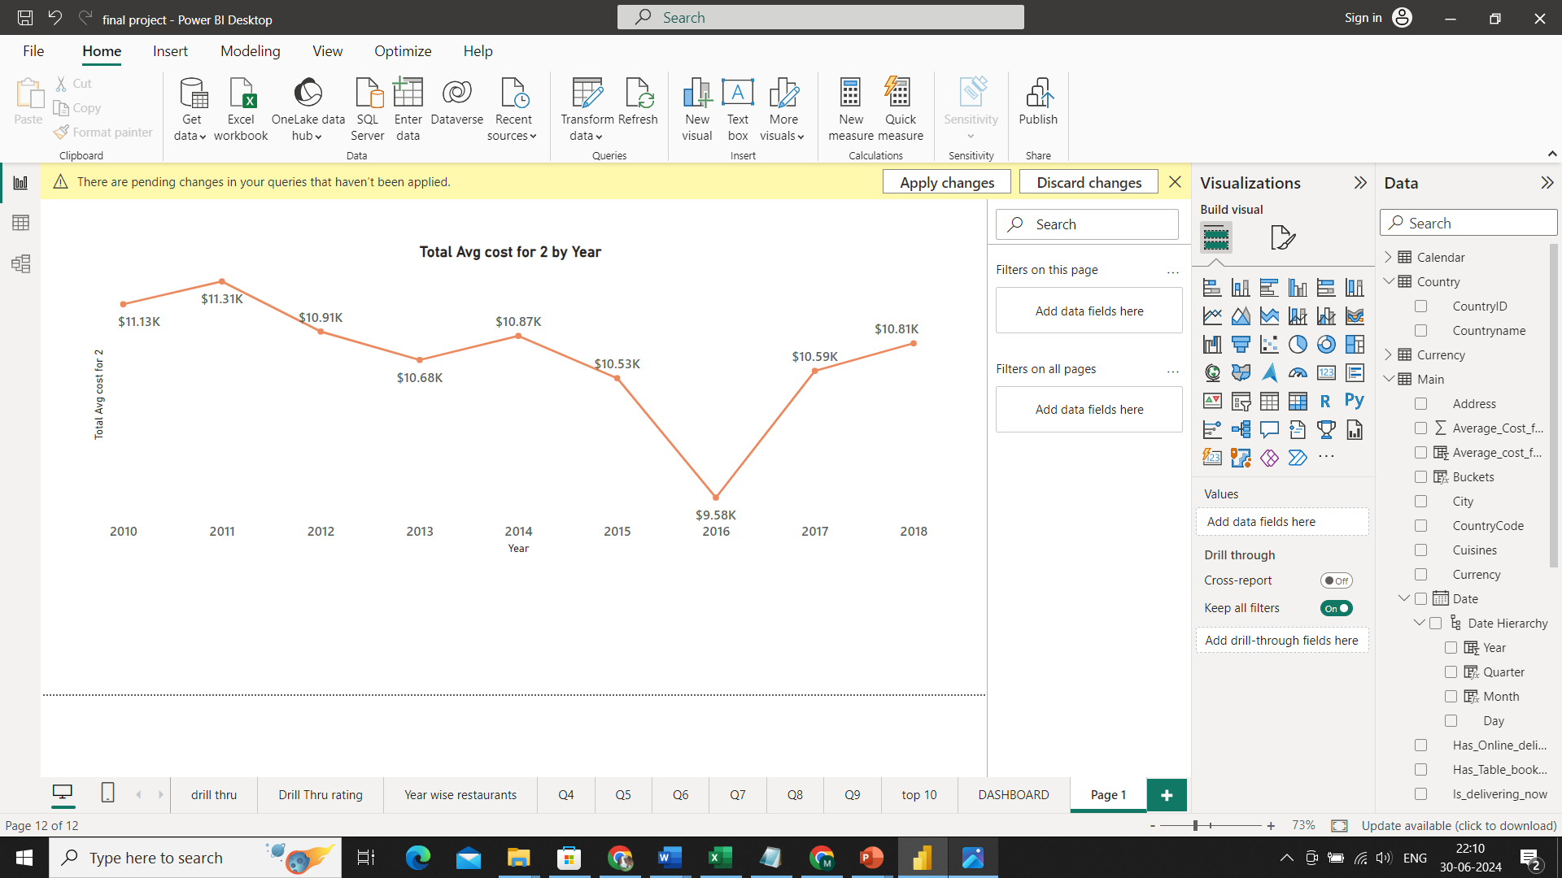
Average Cost Analysis
Total Average Cost By Year
Maximum Average cost is 2011
Minimum Avg Cost in Year 2016
Average Cost is decreasing with Time
2. Cuisines
Cuisines with highest average cost for 2 :
North Indian
North Indian, Chinese
North Indian, Mughlai
Chinese
Cafe
3. Restaurants
Restaurants with highest average cost :
Domino’s Pizza
Barbeque Nation
Restaurant Andre
Café Coffee Day
Spiral - Sofitel Philippine Plaza Manila

Slide 11
RATINGS AND REVIEW ANALYSIS

Slide 12

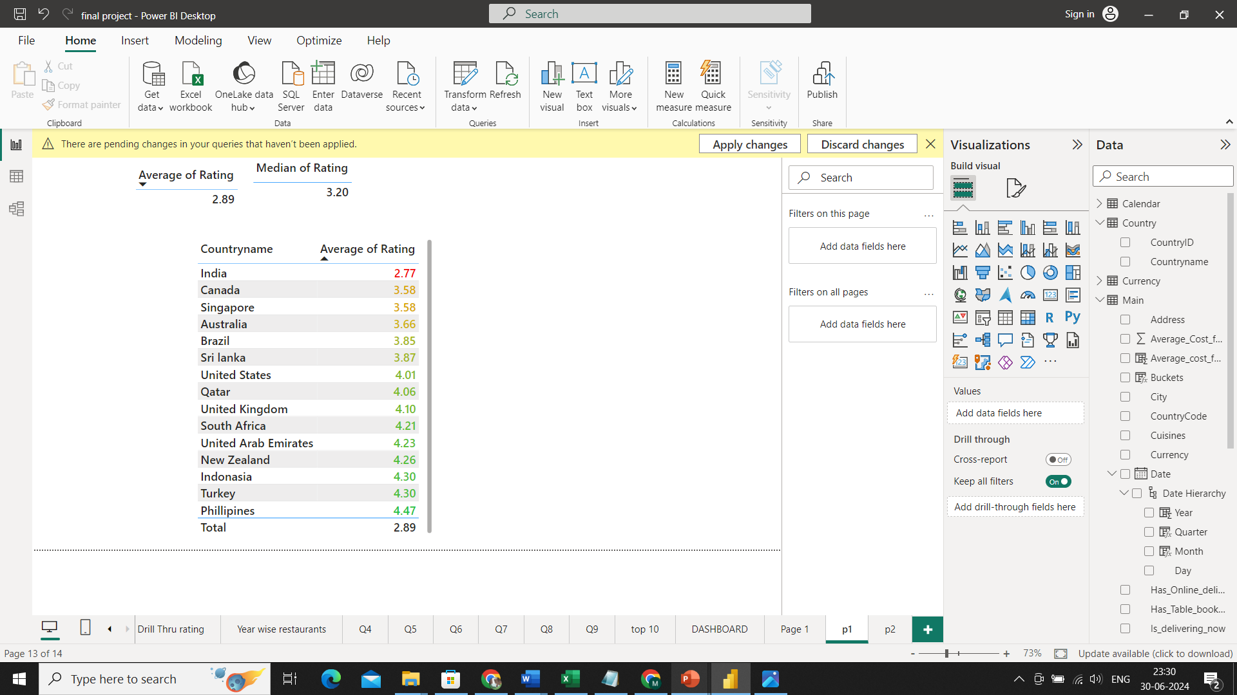
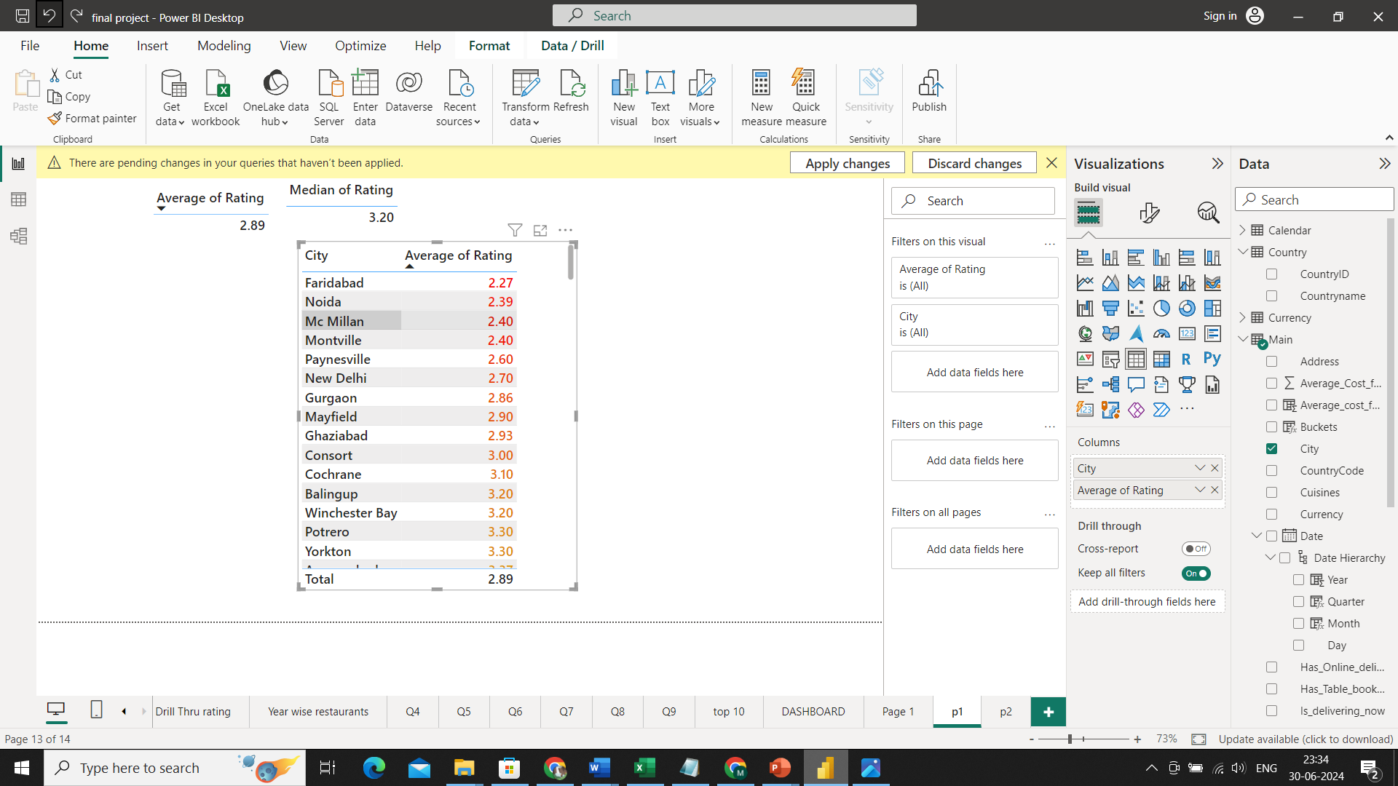
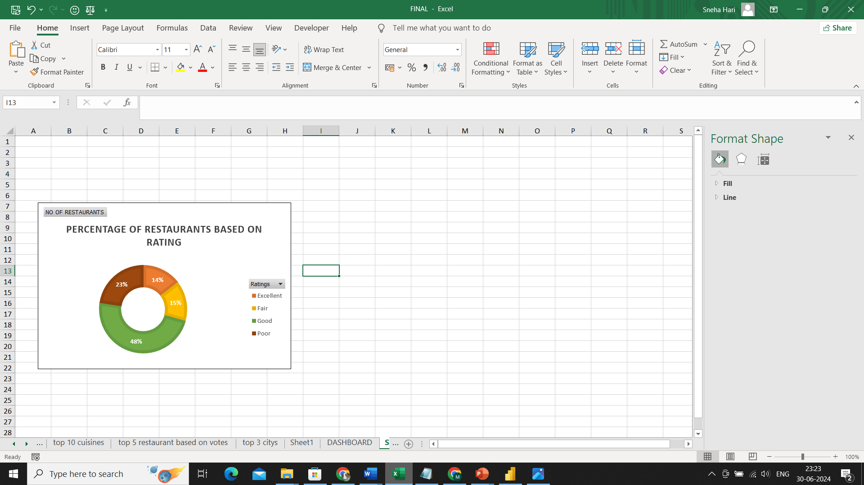
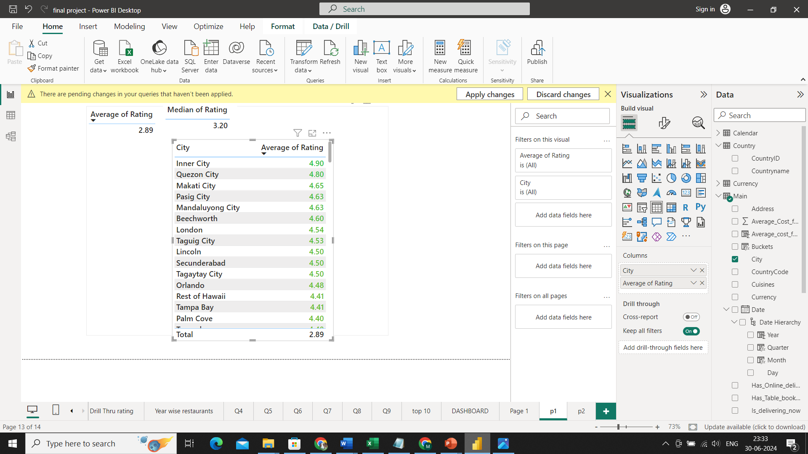
Ratings and Reviews Analysis:
1. Rating Categories
Excellent(1-2): 1423
Good(2-3): 4590
Fair(3-4): 2158
Poor(4-5) 1380
2. Countries
3. Cities
Least Avg Rating
Highest Avg Rating

Slide 13
Ratings and Reviews Analysis:
Basic Insights:
The majority of the restaurants fall into the "Good" rating category (46%), indicating that most establishments have satisfactory ratings.
The "Poor" rating category has the smallest proportion (14%), suggesting relatively fewer restaurants are rated poorly.
Countries like the Philippines, Turkey, and Indonesia have higher average ratings, indicating better customer satisfaction and potentially higher quality of dining experiences.
India has the lowest average rating (2.77), which may suggest room for improvement in customer satisfaction or quality of service.
Cities like Inner City and Quezon City have exceptionally high average ratings, indicating a high level of customer satisfaction.
Cities such as Faridabad and Noida have the lowest average ratings, indicating areas that may require significant improvement in customer service or dining experience.

Slide 14
Ratings and Reviews Analysis:
Additional Findings:
Votes and Ratings:
From the analysis, we found that there is a positive relation between rating and sum of votes, Higher the Rating Higher is the Votes.
This indicates that customers are more inclined to vote when they have a positive experience and customers are less likely to engage or leave feedback when their experience is mediocre or poor.
Buckets and Ratings:
From the analysis, we found that there is a relationship between Buckets and Rating category.
Out of 2158 poor ratings 1704 ratings belongs to restaurants which comes under Lower End Bucket Category which has a price range of 1.
There are 0 poor and fair ratings for restaurants which comes under Higher end buckets which has a price range of 4
This trend underscores the importance of pricing in customer satisfaction, where higher-end establishments tend to offer superior quality and service, resulting in better ratings.

Slide 15
POPULARITY ANALYSIS

Slide 16
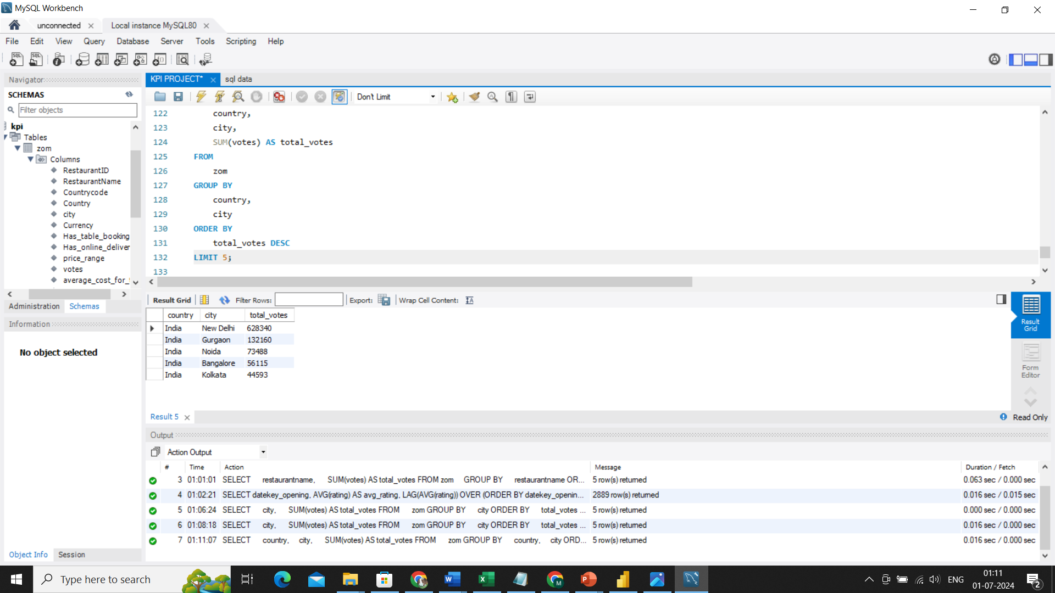
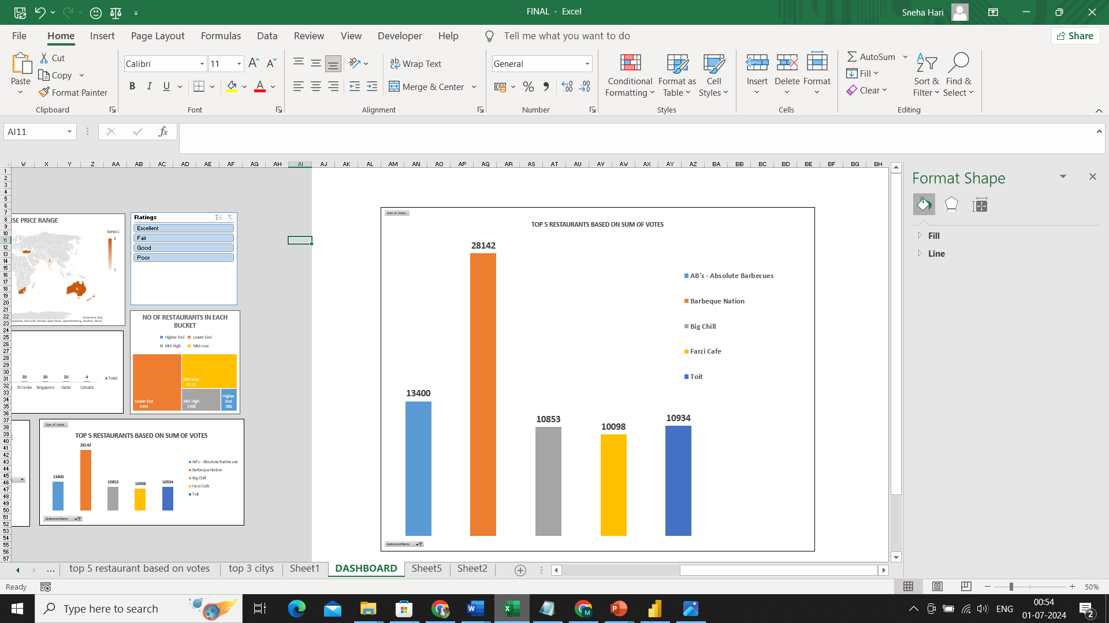
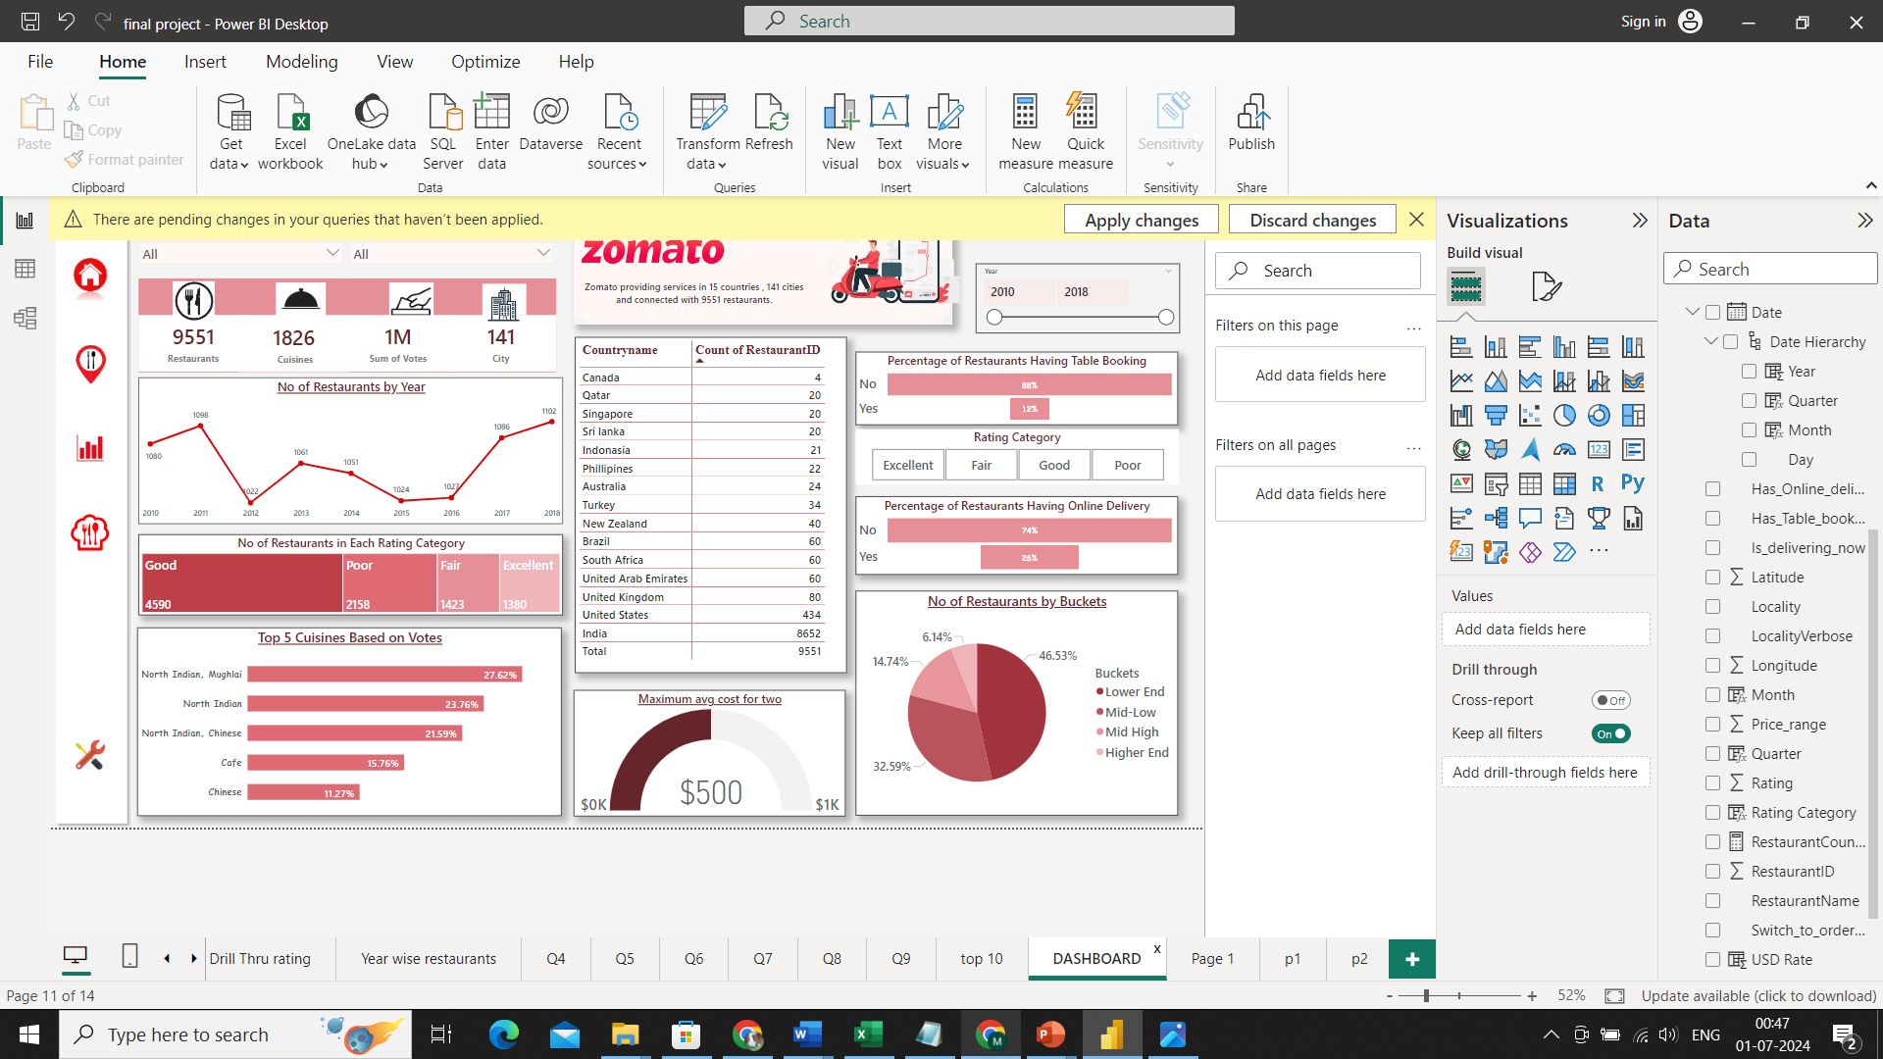

Popularity Analysis:
Most Popular cuisines
North Indian, Mughlai
North Indian
North Indian, Chinese
Cafe
Chinese
Most Popular Restaurants
Countries & Cities
Highest Votes
AB’s – Absolute Barbecues
Barbeque Nation
Big Chill
Farzi Cafe
Toit
Lowest Votes

Slide 17
Popularity Analysis:
Basic Insights:
Popular Cuisines
North Indian cuisine dominates the popularity chart, reflecting a strong preference for this type of cuisine.
The combination of North Indian with other cuisines like Mughlai and Chinese also indicates a trend towards fusion or multi-cuisine offerings.
Popular Restaurants
AB’s – Absolute Barbecues leads in popularity by a significant margin, suggesting a highly favorable customer experience or effective marketing strategies.
Country and Cities (Highest Votes)
Indian cities, particularly New Delhi, receive the highest number of votes, indicating a vibrant and engaged customer base.
The concentration of votes in major Indian cities suggests these areas have a significant influence on the overall popularity metrics.
Country and Cities (Lowest Votes)
Cities with the lowest votes Consort and Cochrane are relatively unknown or have a smaller population, which could impact the number of votes.

Slide 18
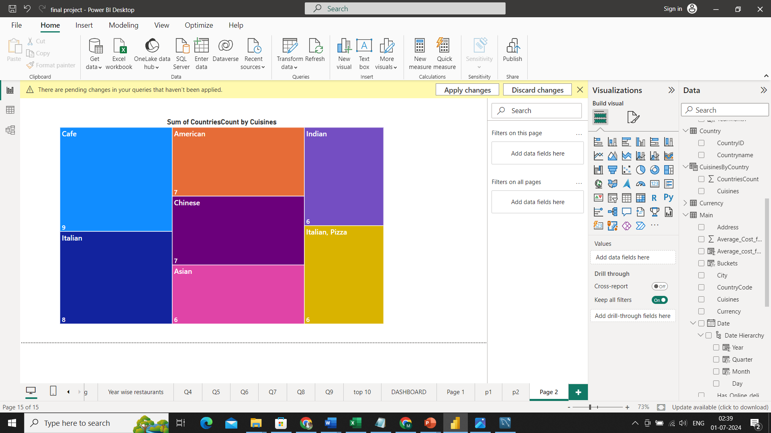
Popularity Analysis:
Additional Findings
Influence of Indian Data:
The popularity of North Indian cuisines (Mughlai, North Indian, North Indian-Chinese) is significantly influenced by the high number of restaurants in India, which has the maximum number of votes and restaurants.
Broader Trend:
Despite the strong influence of Indian data, the cuisine found most consistently across various countries is Cafe. This indicates that Cafe-style cuisine has a broad international appeal and is widely accepted in multiple regions outside India.

Slide 19
RESTAURANT COUNT ANALYSIS

Slide 20
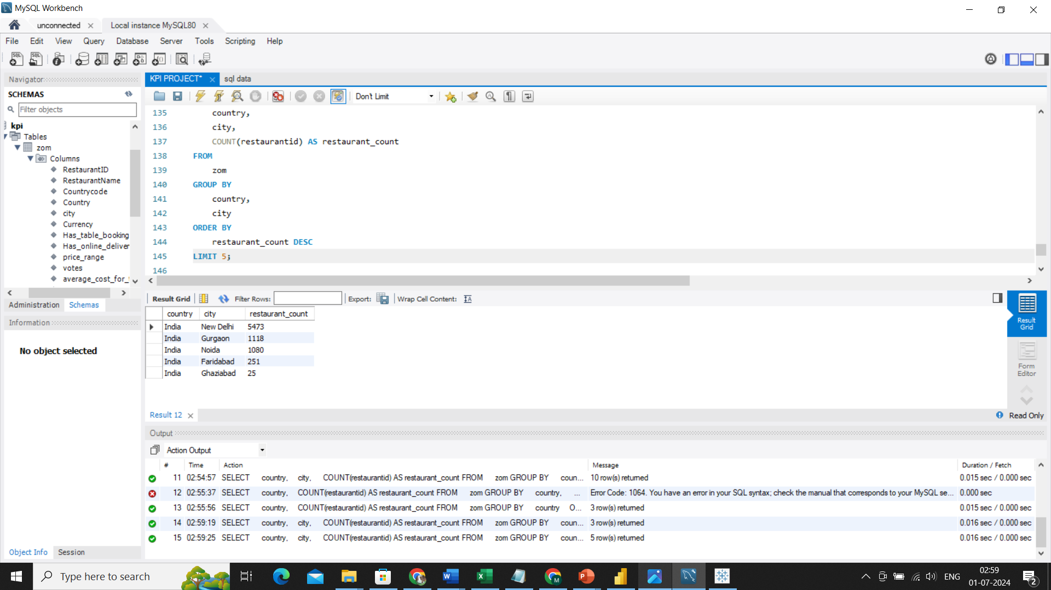
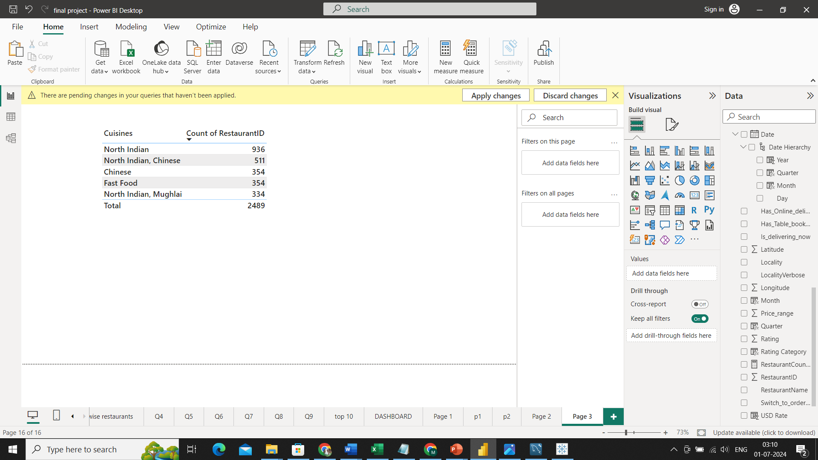
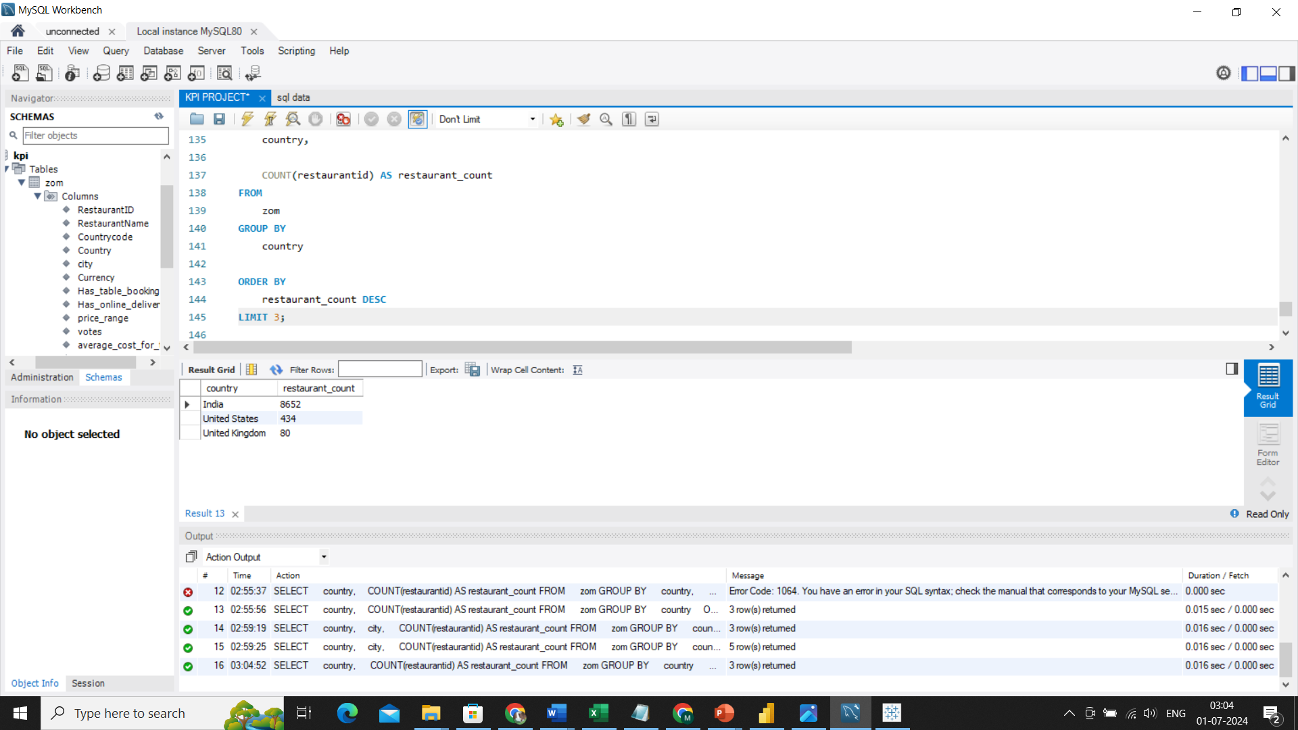

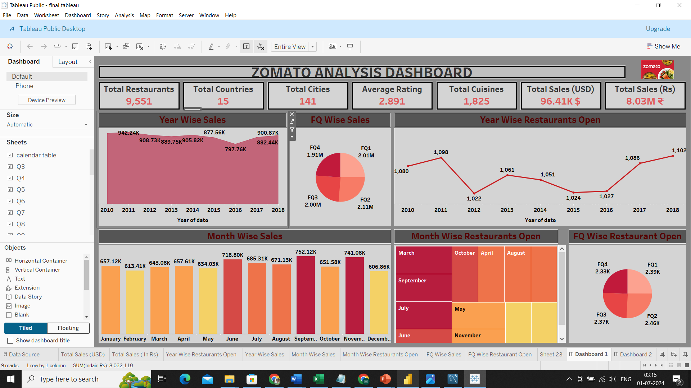
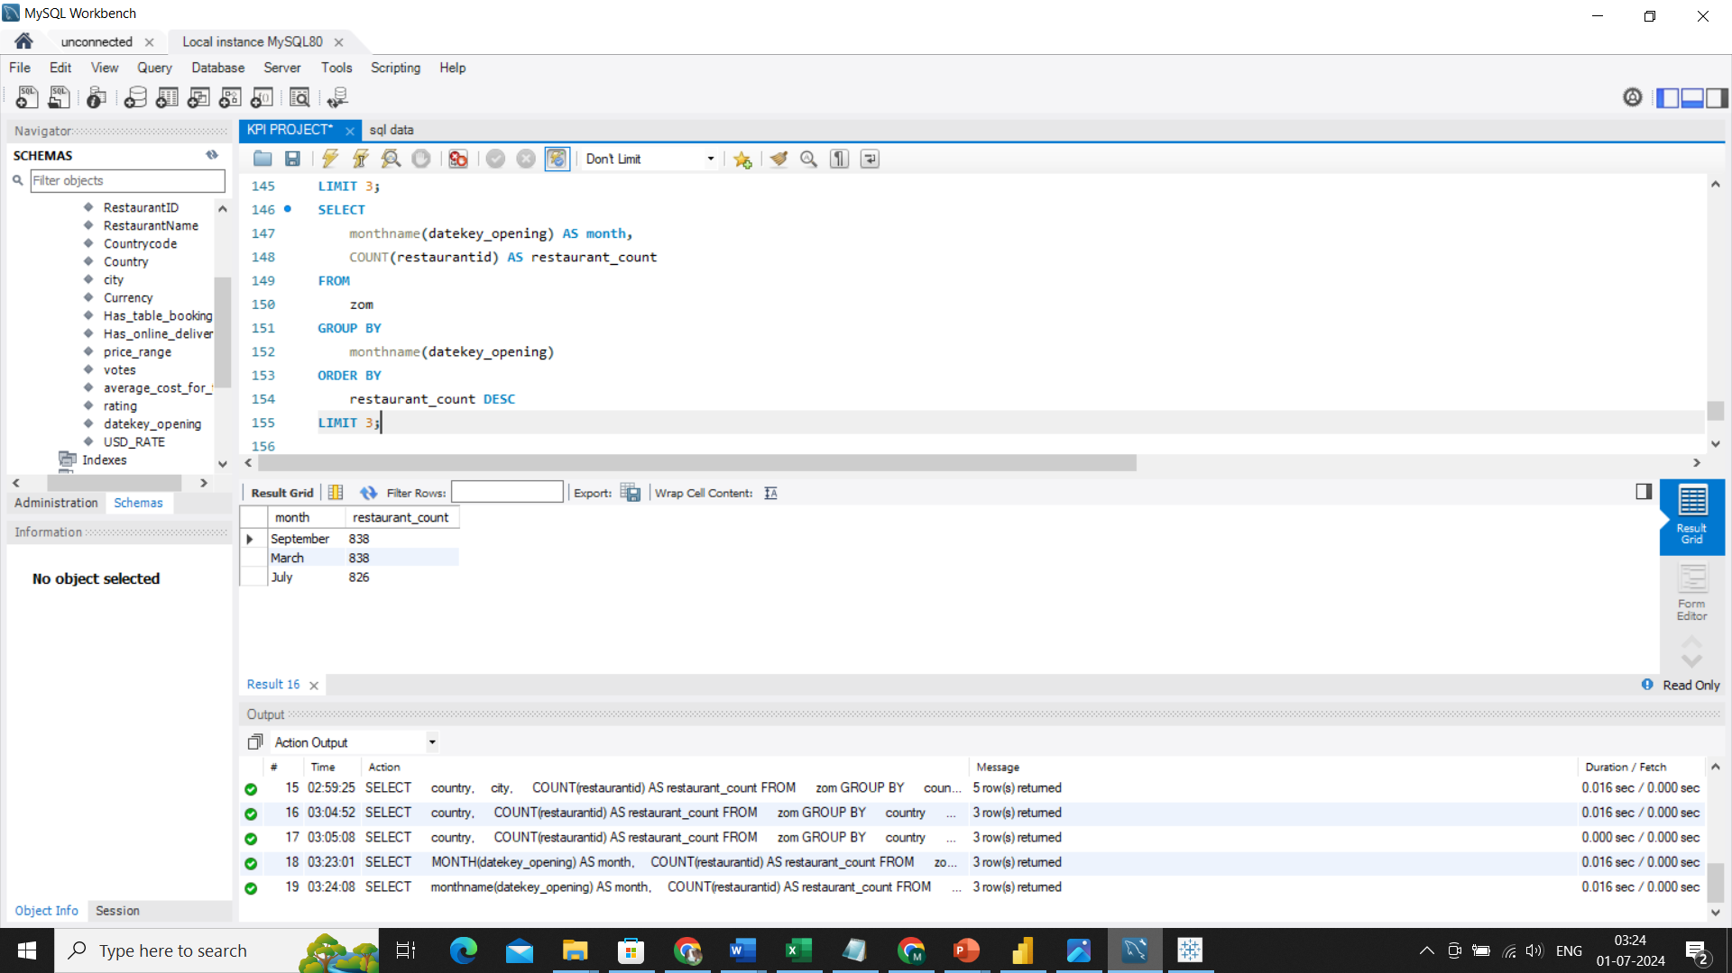

Restaurant Count Analysis:
Cities with Maximum No of Restaurants
Cuisines with Max No of Restaurants
Countries
Highest No of Restaurants
Lowest No of Restaurants
Highest and Lowest Restaurant Opened months

Slide 21
Restaurant Count Analysis:
Basic Insights:
Countries with the Highest and Lowest Number of Restaurants:
India has the highest number of restaurants (8652) , followed by the United States (434) and the United Kingdom (80).
Canada, Qatar, and Singapore have the lowest number of restaurants, with counts of 4, 20, and 20 respectively.
Cities with Maximum Number of Restaurants:
New Delhi leads with 5473 restaurants, followed by Gurgaon (1118) , Noida (1080) , Faridabad (251) , and Ghaziabad (25) . This indicates a high concentration of restaurants in these cities, particularly in New Delhi.
Cuisines with Maximum Number of Restaurants:
North Indian cuisine is the most prevalent with 936 restaurants. It is followed by North Indian and Chinese (511), Chinese (354), Fast Food (354), and North Indian and Mughlai (334). This shows a strong preference for North Indian cuisine.
Year-wise Restaurants Opened:
There is a fluctuating trend in the number of restaurants opened each year, with notable peaks in 2011 (1098) and 2018 (1102).

Slide 22

Restaurant Count Analysis:
Basic Insights:
Quarter-wise Restaurant Openings:
Restaurant openings are relatively evenly distributed across quarters, with Q1 (2.39K) , Q2 (2.46K) ,
Q3 (2.37K) and Q4 (2.33K). This suggests a steady rate of restaurant openings throughout the year.
Months with Highest and Lowest Restaurant Openings:
September and March see the highest number of restaurant openings (838 each) , while February has the lowest (745).
Additional Findings:
Weekend Surge: Analysis reveals a notable trend where a majority of restaurants on Zomato are open during weekends, aligning with increased user demand and dining-out behavior

Slide 23
SERVICE AVAILABILITY ANALYSIS

Slide 24
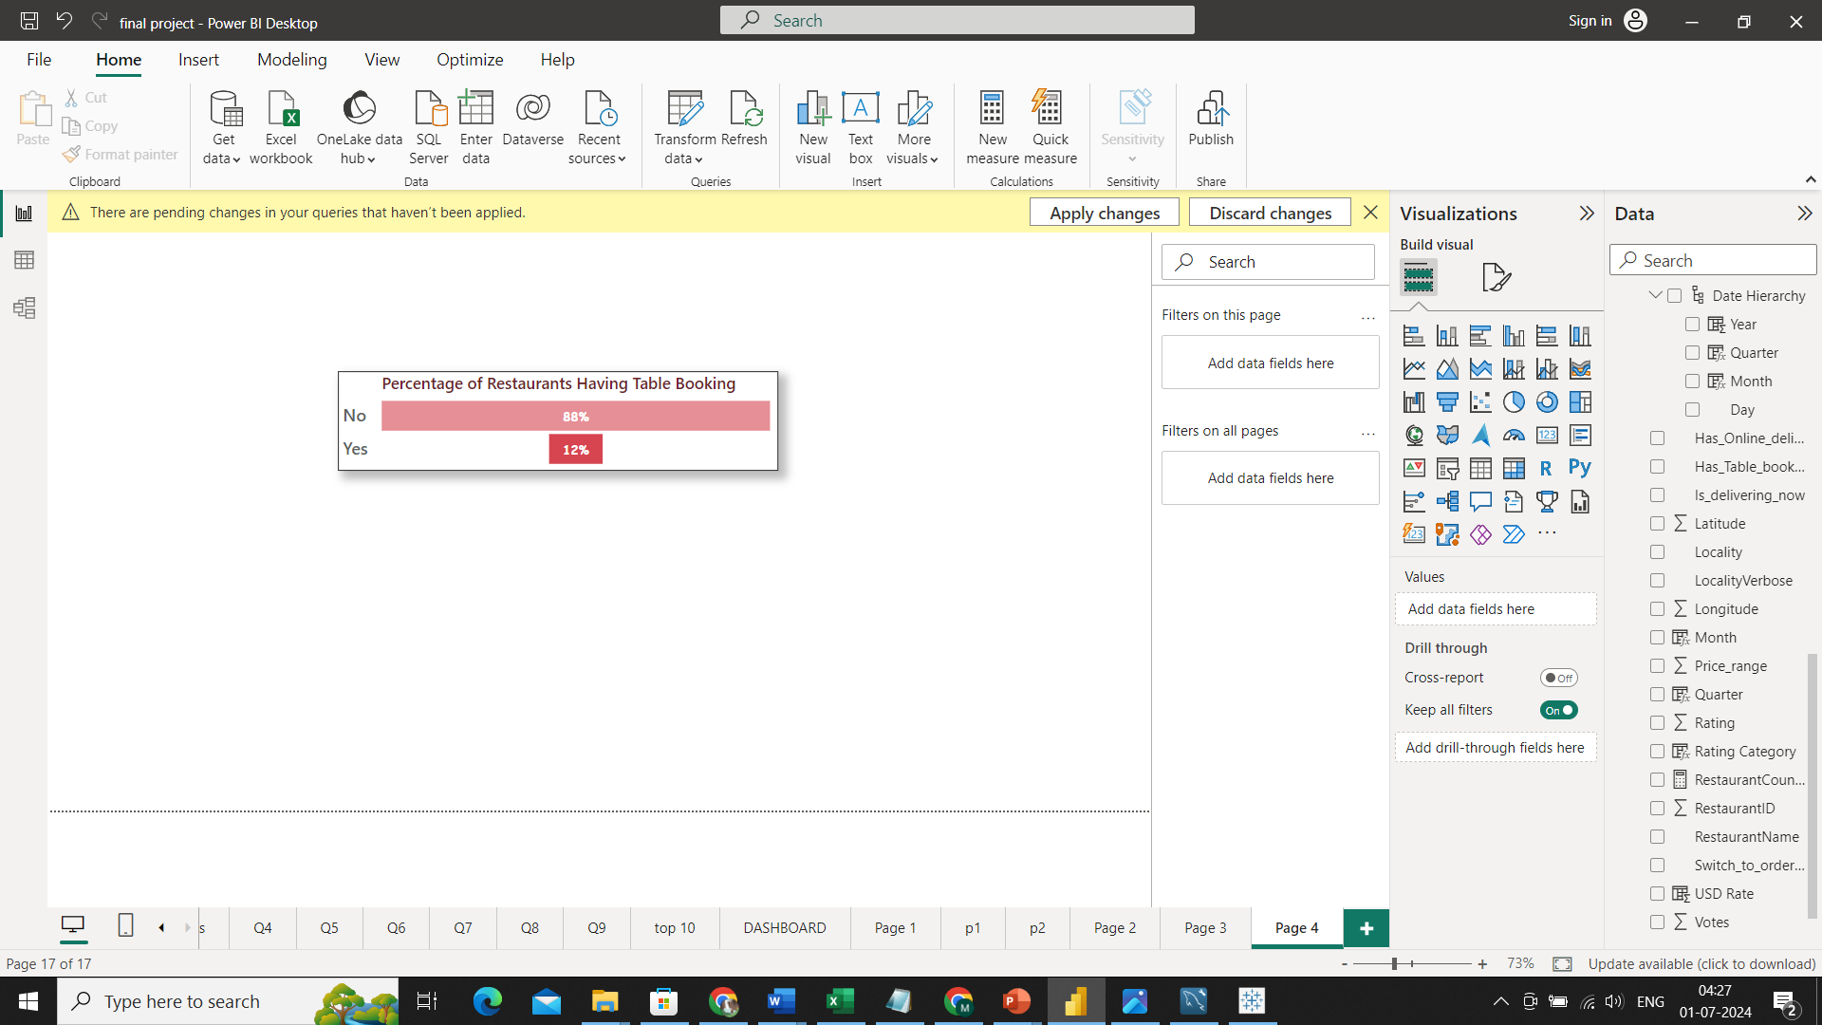

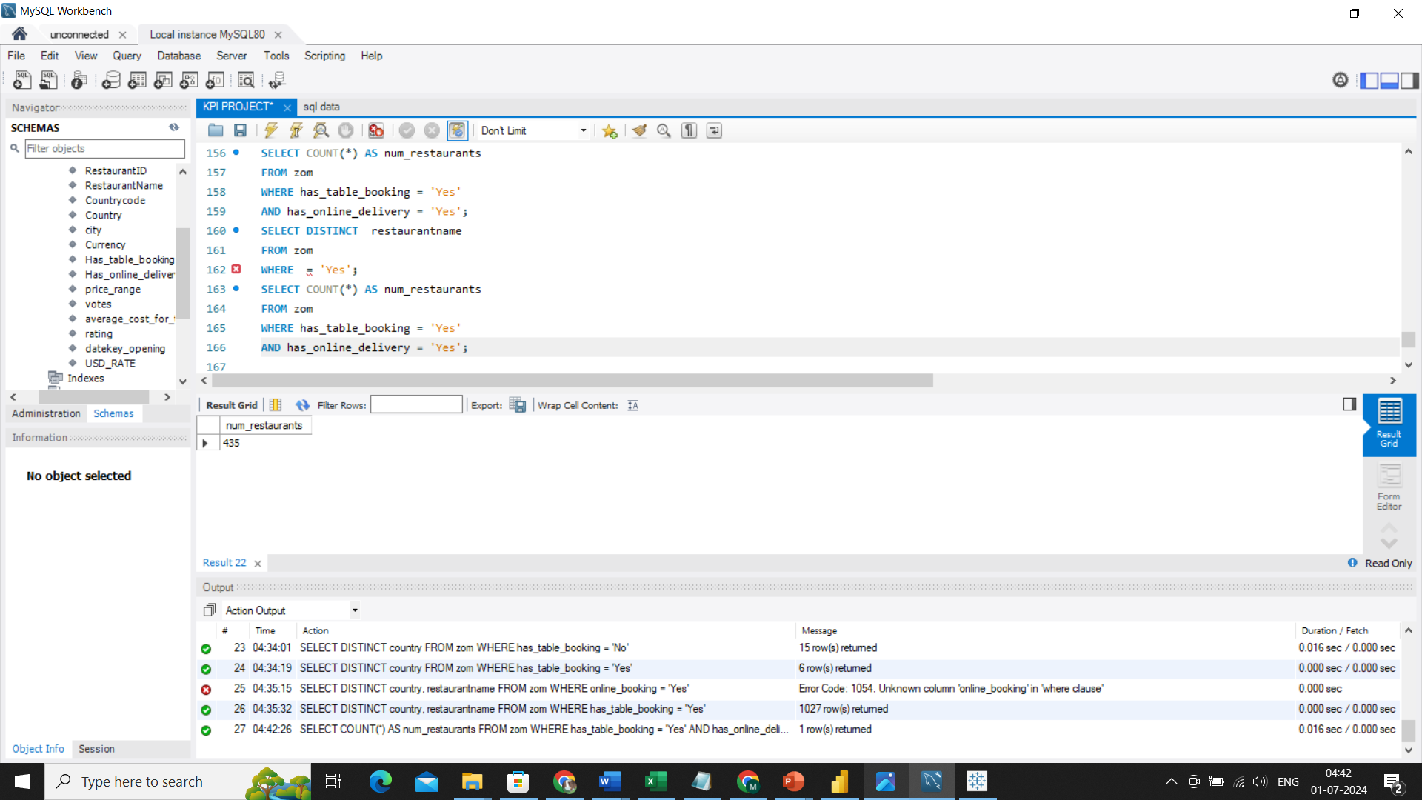
Service Availability Analysis
Having Table Booking
Having Online Delivery
Count of Restaurants Having both Table Booking and Online Delivery

Slide 25
Service Availability Analysis:
Basic Insights:
Growing Online Delivery Trend:
A notable portion of restaurants (26%) have adopted online delivery, reflecting a shift towards accommodating consumer preferences for convenience.
Service Overlap:
A small segment of the market (435 restaurants) caters to customers by offering both services, highlighting a niche but potentially valuable group that balances dine-in and delivery operations.
Limited Adoption of Table Booking:
The majority of restaurants (88%) do not provide table booking services, indicating either a low demand or the potential for growth in this area.

Slide 26
Observations and Strategy Implementation

Slide 27
Observations & Strategy Implementation
Cafe and Italian Cuisines Lead:
Observation: Cafe and Italian cuisines are the most internationally prevalent, suggesting they have broad global appeal and market acceptance.
Strategy : Leverage the popularity of Cafe and Italian cuisines by expanding their offerings, introducing new menu items, and enhancing marketing efforts in existing and new markets.
Focus on High-Demand Areas:
Observation: High concentration of restaurants in specific regions (New Delhi, Gurgaon, Noida).
Strategy: New ventures should consider these areas for better market opportunities, but also focus on differentiation strategies due to high competition.
Target Emerging Markets:
Observation: Low number of restaurants in Canada, Qatar, and Singapore.
Strategy: Expand chains to these countries to capture untapped demand.
Seasonal Marketing Strategies:
Observation: Peaks in restaurant openings in March and September.
Strategy: Implement targeted marketing campaigns and promotions during these times to capitalize on increased market activity.

Slide 28
Observations & Strategy Implementation
5. Customer Feedback and Continuous Improvement :
Observation: Importance of customer feedback.
Strategy : Collect and analyse feedback regularly, and implement continuous training programs for staff
6. Boost Presence in Low-Engagement Areas :
Observation: Low engagement in some areas based on votes
Strategy: Conduct market research and develop localized marketing strategies.
7. Responding to Decreasing Average Costs Over Time
Observation: The average cost for dining is decreasing over time.
Strategy: Introduce cost-effective dining options and value meals to adapt to the trend of decreasing average costs and appeal to a broader customer base.
8. Enhancing Affordability in Low-Cost Regions
Observation: Sri Lanka has the lowest maximum average cost for two people at $15.3, suggesting a more affordable dining scene.
Strategy: Highlight Sri Lanka’s affordability in marketing materials to attract budget-conscious travellers and dining enthusiasts.

Slide 29
Observations & Strategy Implementation
9. Boost Presence in Low-Engagement Areas:
Observation: Low engagement in some areas based on votes.
Strategy : Conduct market research and develop localized marketing strategies.
10. Technological Integration and Support
Observation: Need for a unified system for table booking and online delivery.
Strategy: Develop and promote a unified system within Zomato that integrates table booking and online delivery management for restaurants.
11. Increasing Service Availability
Observation: Enhancing overall dining experience through service availability.
Strategy: Increase the availability of table booking and online delivery to at least 50 percent to offer flexibility and convenience.
12. Addressing Poor Ratings in Lower-End Buckets
Observation: 79% of poor ratings are for restaurants in the lower-end bucket category (price range of 1).
Strategy: Implement quality improvement programs and staff training for lower-end bucket restaurants to enhance service and food quality, aiming to boost customer satisfaction and ratings.

Slide 30
Conclusion

Slide 31



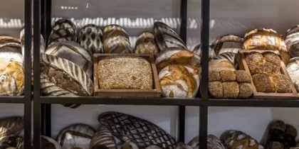
Summary
The Zomato analysis project provided valuable insights into restaurant dynamics and consumer preferences, leveraging a rich dataset to uncover actionable information for stakeholders, restaurant owners and consumers
By summarizing these insights in a clear and concise manner, stakeholders can confidently make decisions that improve dining experiences and business performance within the competitive restaurant industry.

Slide 32


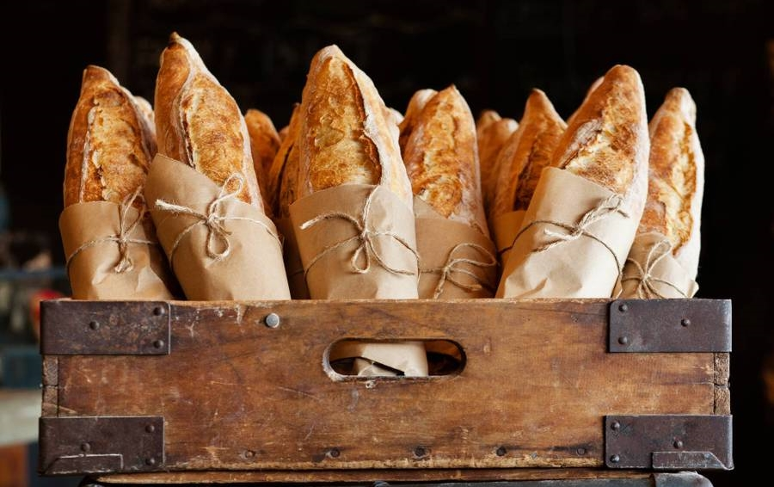
"Discover, Dine, Delight – Elevate Every Meal with Zomato!"

Slide 33
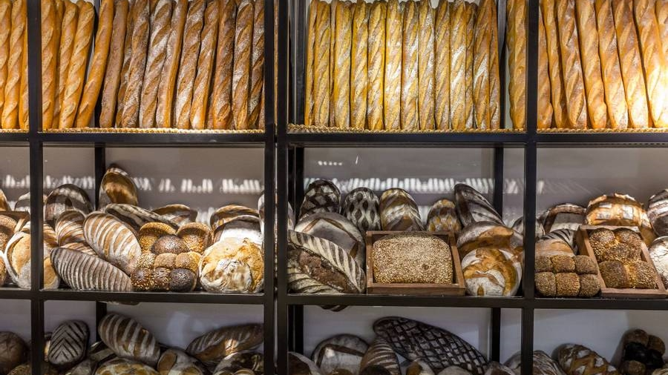
Thank you
Sneha Hari
Shweta Pamnai
Yash Mandle
33

